Slide 1
Milestone 5 – Simulation Program

Slide 2
Content
Model’s Structure
Implementation
Changes from the Conceptual Model
Future Plan
Project Circumstance
Lesson Learned
Milestone 5 – Simulation Program

Slide 3
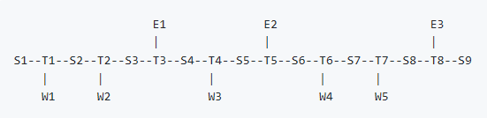
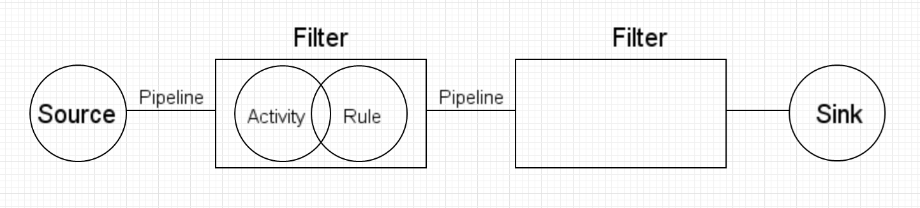
Pipe and Filter Structure
Suitable for a system with independent steps
Exhibits concurrence processing
Easy to extend by adding filter and by reusing filters
Milestone 5 – Simulation Program

Slide 4
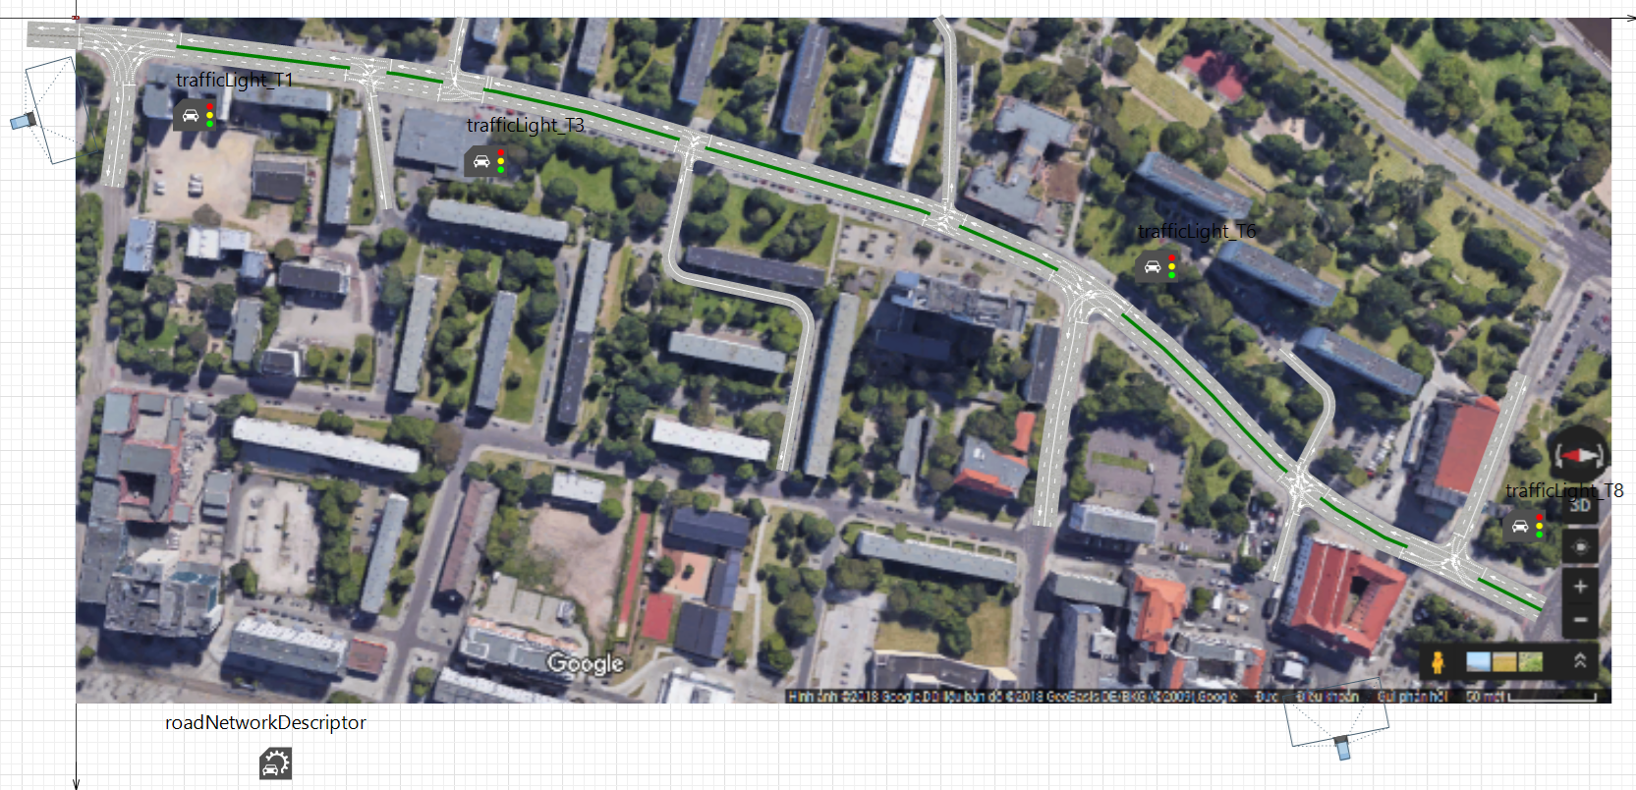
Implementation - Map
Milestone 5 – Simulation Program

Slide 5
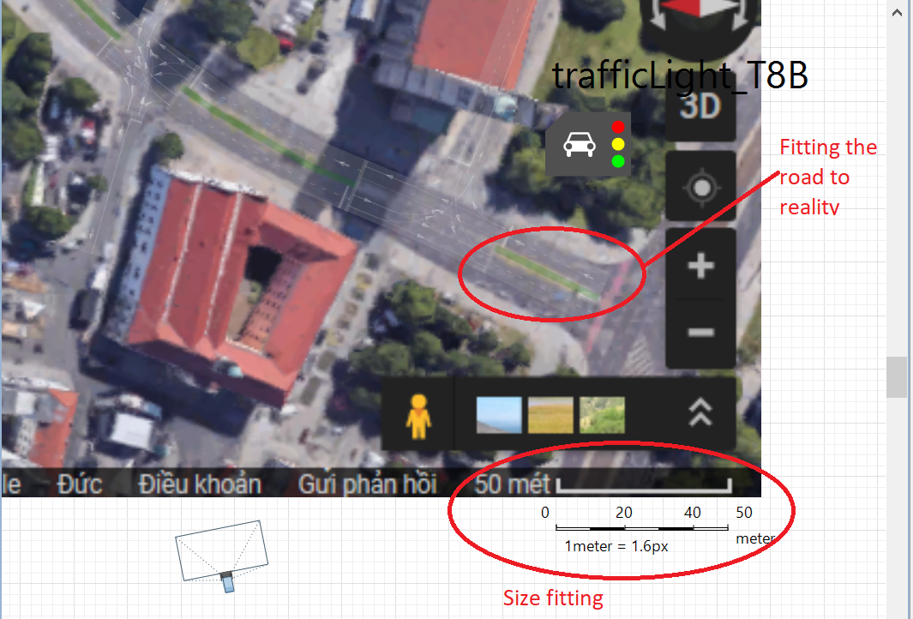
Implementation – Close up
Milestone 5 – Simulation Program

Slide 6
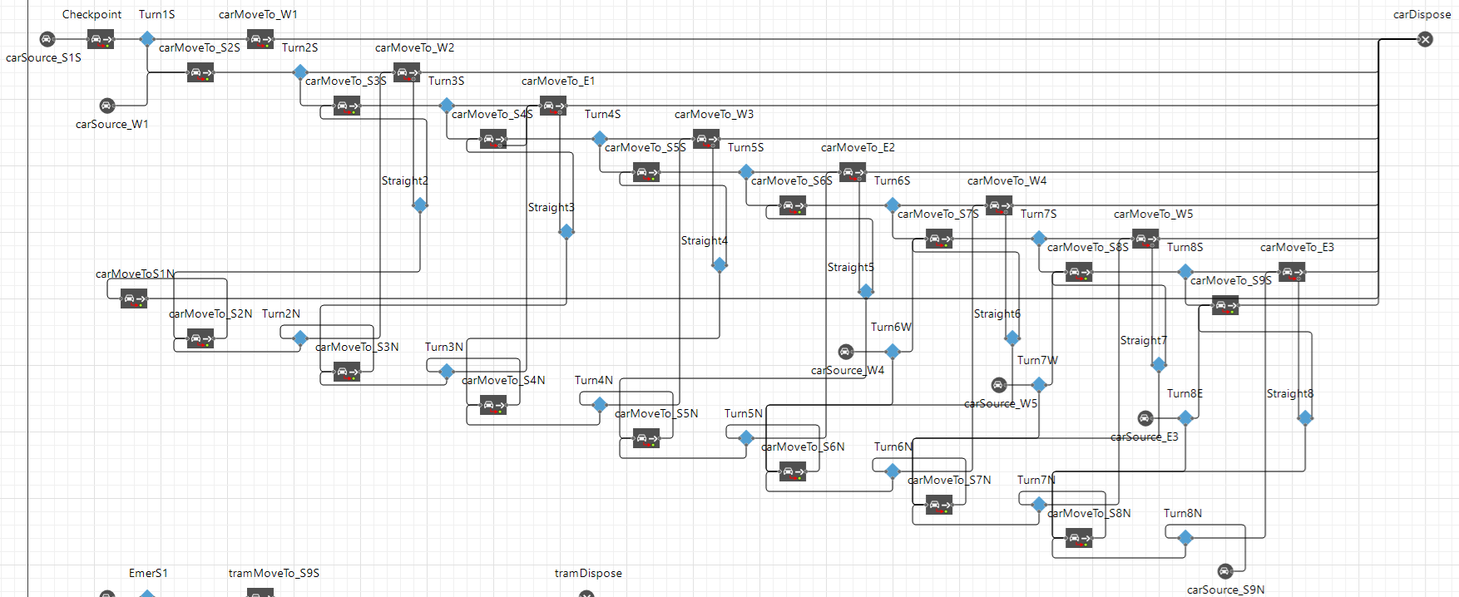
Implementation - Network
Milestone 5 – Simulation Program

Slide 7
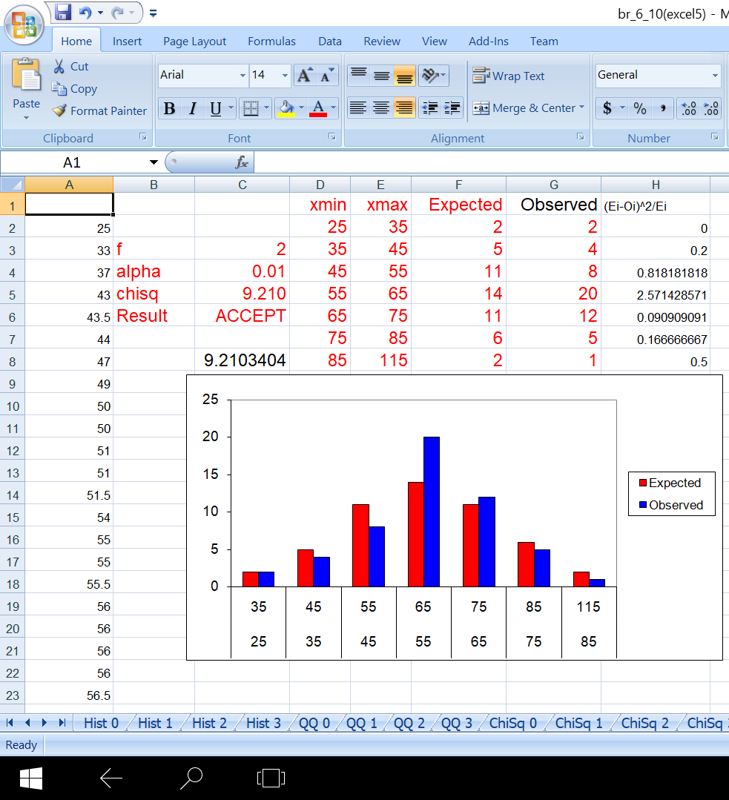
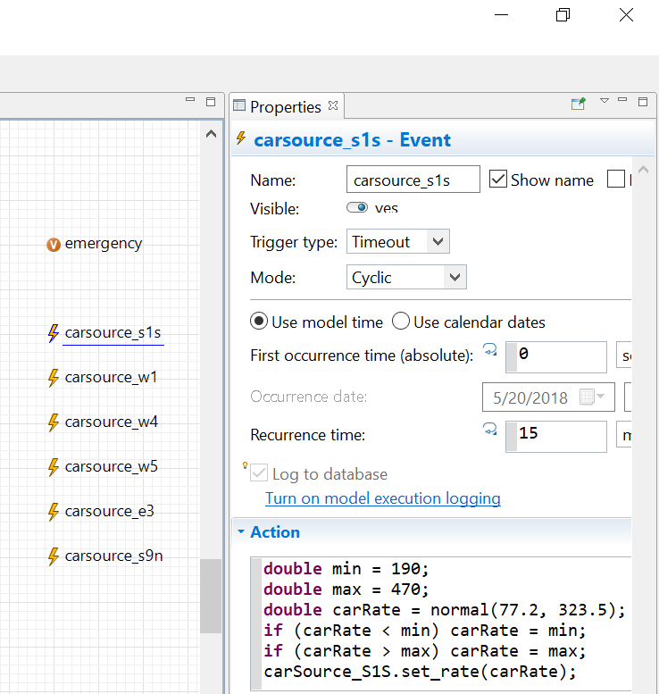
Implementation - Car Source
Milestone 5 – Simulation Program

Slide 8
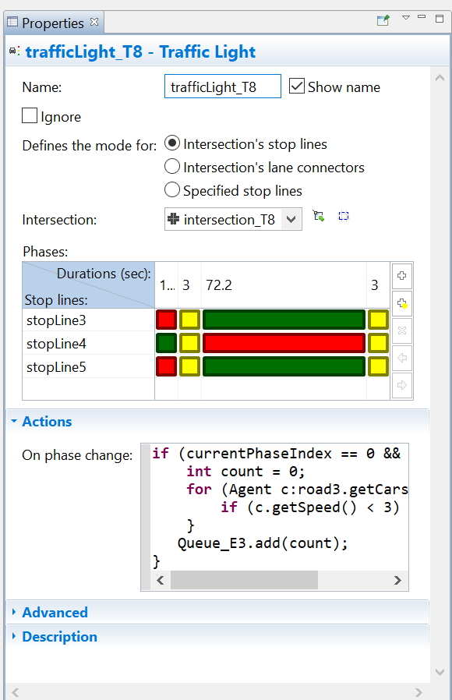
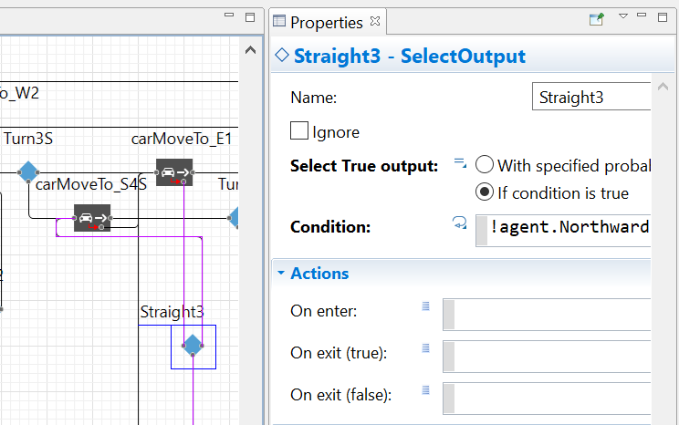
Implementation - Activity
Milestone 5 – Simulation Program

Slide 9
Changes from the Conceptual Model
Shorter road: cut off Ernst-Reuter-Allee and Walther-Rathenau-Straße
Two more important crossroad: Johannisbergstraße and Bei der Hauptwache
Pedestrian crosswalk near Mühlenstraße
Milestone 5 – Simulation Program

Slide 10
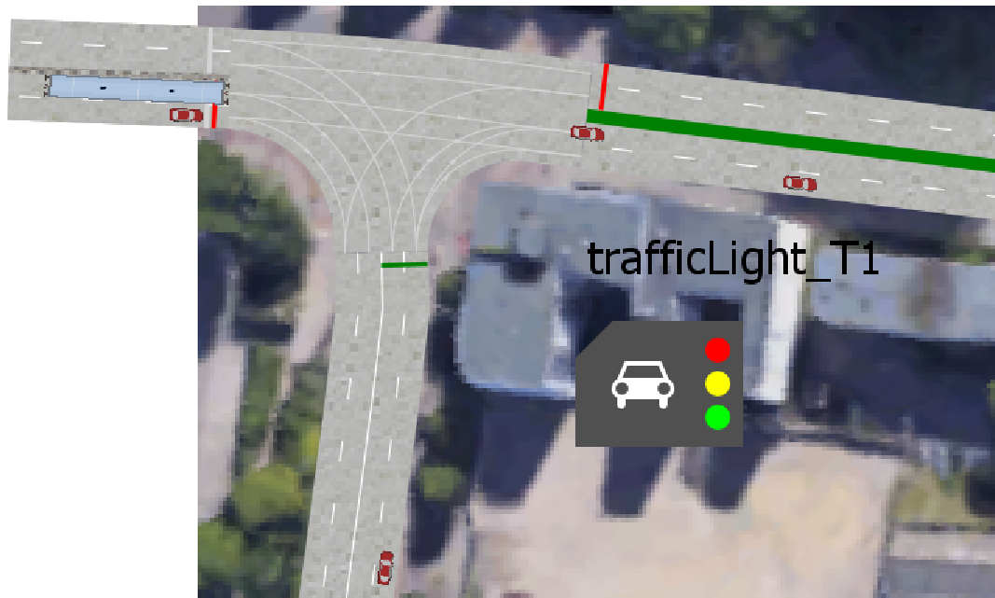
Difficulties
Lane Prioritizing Problem
Milestone 5 – Simulation Program

Slide 11
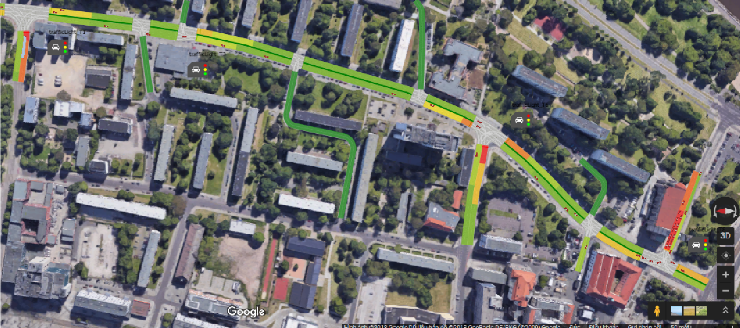
Future Plan
Milestone 5 – Simulation Program

Slide 12
Project Schedule
Milestone 5 – Simulation Program

Slide 13
Cost Plan
Milestone 5 – Simulation Program

Slide 14
SIMTECH – So Far
Budget: 24.325 € spent
Lesson learned:
Prepare ahead: the content of next milestone might be a guidance for the current milestone.
Stay healthy
Milestone 5 – Simulation Program

Slide 15
THANK YOU FOR YOUR ATTENTION
Milestone 5 – Simulation Program

